Slide 1
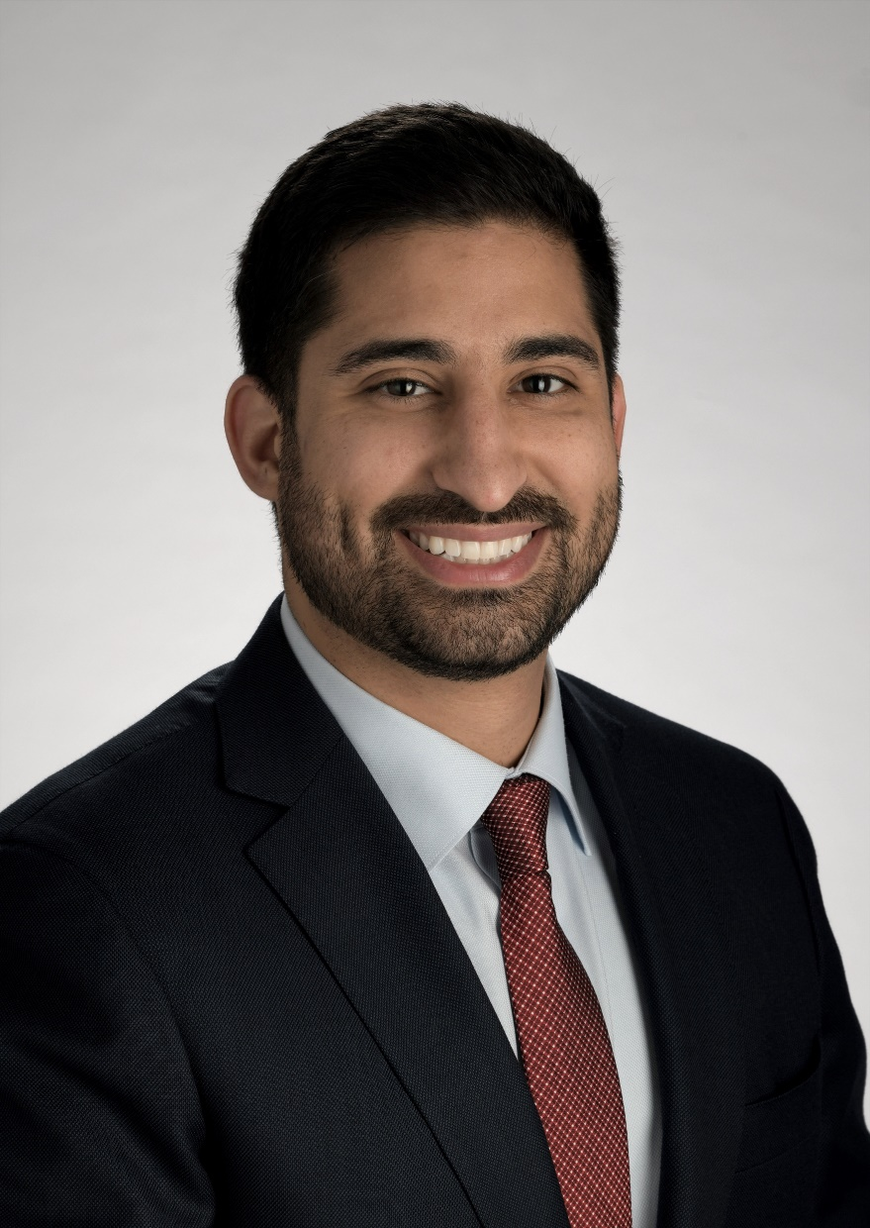
Omar Karadaghy, MD, MSCI
Otolaryngology
Head and Neck Oncology and Microvascular Reconstruction
Medical School: University of Missouri – Kansas City
Residency: University of Kansas Medical Center
Fellowship: Massachusetts Eye and Ear – Harvard University

Slide 2
Clinical Focus
Malignancies of upper aerodigestive tract, skull base, thyroid, and cutaneous of the head and neck
Complex reconstruction of head and neck defects
Robotic surgery
Clinical outcomes and surgical outcomes research
  Machine Learning focus with experience in deep learning
  Surgical de-escalation in HPV+ OPSCCa including identifying optimal margins
  Neoadjuvant “Window of Opportunity” trials
  3D printing for modeling of complex defects, hardware engineering

Slide 3
Clinical/Surgical Locations
KU Medical Office Pavilion
  2052 Olathe Blvd, Kansas City, KS 66160
KU MedWest Medical Pavilion
  7405 Renner Rd, Shawnee, KS 66217
  Email: okaradaghy@kumc.edu
  Cell: 314-757-8052
  Nurse: Paige Gerant pgerant@kumc.edu

